Slide 1

Senior Design Project I
Week 6: Project Specifics
Presenter: Josheb P. Dayrit

Slide 2

A Webinar in MATLAB
Goal?
To identify the physical activity that a human subject is engaged in, solely based on the accelerometer
signals generated by his or her smartphone.
Types of physical activity monitored: Walking, Walking Upstairs, Walking Downstairs, Laying, Sitting, and
Standing.
A machine learning algorithm on MATLAB was used for classification purposes.

Slide 3
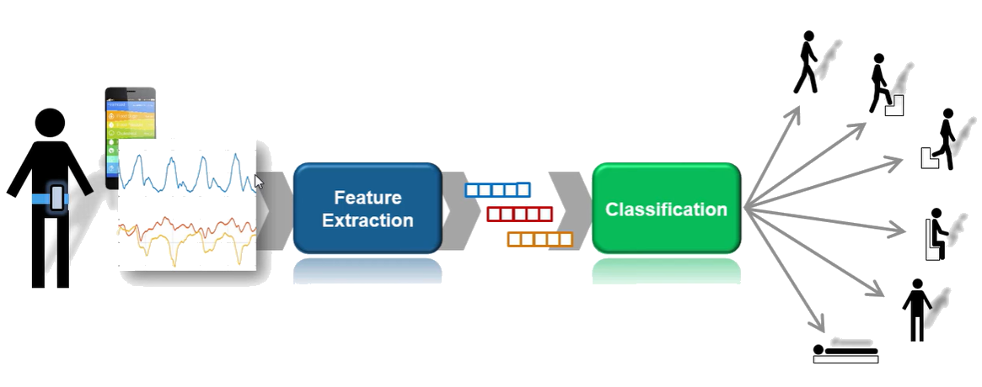
The Overall Process

Slide 4
Feature Engineering
Overview
Machine learning algorithms don’t know what to do with raw data.
They need to be told what to look out for. They need guidance.
This guidance comes in the form of “features.”
“Features” = numerical characteristics in data.
Features should capture similarities between similar sets of data, and differences between different
sets of data.

Slide 5
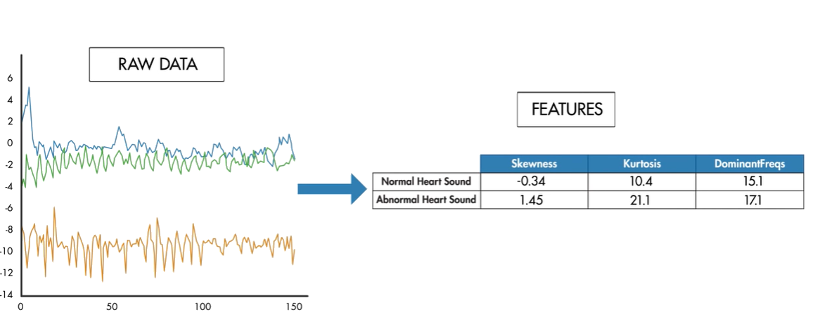
Feature Extraction
Notes:
Raw data depicts heartbeat waveforms. We don’t know if they’re normal or not.
Features table tells us the defining characteristics of a normal and abnormal heartbeat waveform.
We can use said table to classify unknown waveforms.

Slide 6
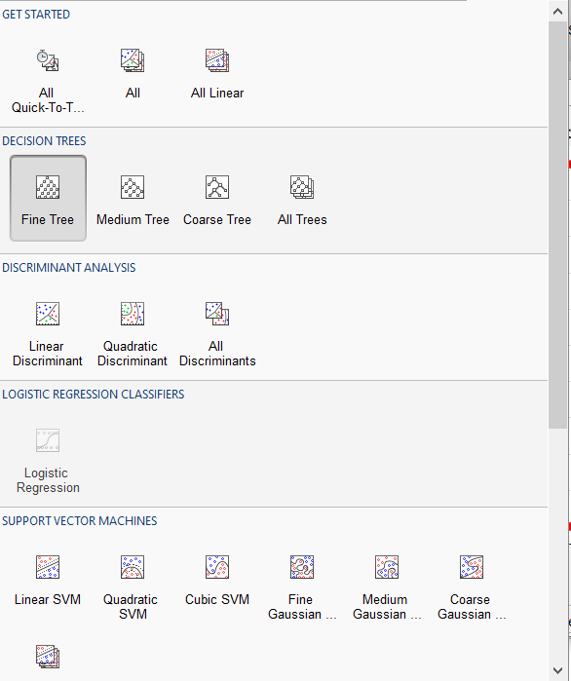
Classification Algorithms
Machine Learning
Machine learning algorithms are readily available
in the Classification Learner app.

Slide 7
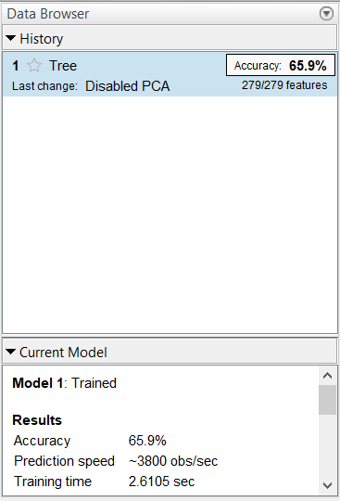
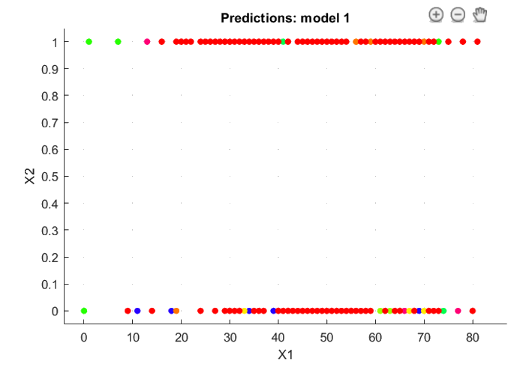
Classification Learner
Notes:
I played around with MATLAB using a sample data.
Arrythmia or no arrythmia.
Data Browser displays accuracy of trained machine learning model.
Graph tells you which predictions were correct. Color tells you the prediction made. Can also tell you incorrect predictions.
Next, back to the webinar.

Slide 8
Webinar Output
Notes:
After doing training in the Classification Learner app, this was the result.

Slide 9
My Project
Overview
I hope to use the Classification Learner app for ASL gesture recognition.
The why’s:
1. It’s easy to use (has a navigable UI)
2. Datasets are simple to load and have a standardized format (formats accepted: Excel, CSV).
3. Results are interpretable (you can see the effect that adding a feature has on your model’s accuracy.

